Slide 1


Routing
November 2014
This document is confidential and contains proprietary information, including trade secrets of CitiusTech. Neither the document nor any of the information contained in it may be reproduced or disclosed to any unauthorized person under any circumstances without the express written permission of CitiusTech.

Slide 2
Agenda
Client Side Routing
Configuring Routes Using $routeProvider
$route, ng-view
$routeParams
Accessing current route

Slide 3
Client Side Routing (1/3)
Angular SPA uses client side routing as against traditional server side routing
With client-side routing, initial request loads the Main/Home page layout from server and css and JavaScript libraries
Main page has the client side URLs which route on client side
Every route is mapped to its associated html template and controller on client side
Client side routes don’t need entire page refresh, only the data changes to be loaded from its associated html template (client side) onto the main page

Slide 4
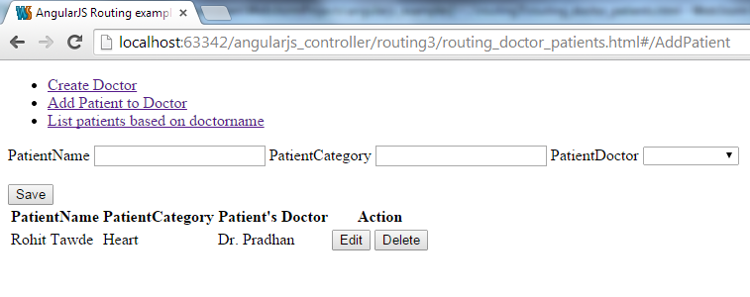
Client Side Routing (2/3)
Angular allows to create client side URLs in view using hashtag # as follows:
<ul class="nav">
<li><a href="#CreateDoctor"> Create Doctor</a></li>
<li><a href="#AddPatient"> Add Patient to Doctor </a></li>
<li><a href="#ListDoctorPatient">List patients based on doctorname </a></li>
</ul>

Slide 5
Client Side Routing (3/3)
We need to map each route to html template and controller on client side as follows:
$routeProvider.when('/AddPatient', {
templateUrl: 'template/add_patient.html',
controller: 'AddPatientController‘ }).
<div ng-view></div> - ng-view directive marks place on Main/index page where html template gets loaded

Slide 6
Agenda
Need for Routing
Configuring Routes Using $routeProvider
$route, ng-view
$routeParams
Accessing current route

Slide 7
Defining Routes Using $routeProvider
Used for configuring client side routes
Methods
when(path, route)
Adds new route definition to $route service
otherwise
Sets route definition that will be used on route change when no other route definition is matched.
var sampleApp = angular.module(‘sampleApp', ['ngRoute']);
sampleApp.config(function($routeProvider) {
$routeProvider.
when('/CreateDoctor', {
templateUrl: 'template/create_doctor.html',
controller: 'DoctorController'
}).
when('/AddPatient', {
templateUrl: 'template/add_patient.html',
controller: 'AddPatientController'
}).
otherwise({ redirectTo: '/CreateDoctor‘ });
});
Notes:
Properties
caseInsensitiveMatch
A boolean property indicating if routes defined using this provider should be matched using a case sensitive algorithm.
Defaults to false.

Slide 8
Agenda
Need for Routing
Configuring Routes Using $routeProvider
$route, ng-view
$routeParams
Accessing Current Route

Slide 9
$route
Used for deep-linking URLs to controllers and views
It watches $location.url() and tries to map the path to an existing route definition
Requires ngRoute module to be installed
This service is used in conjunction with ngView directive and $routeParams service

Slide 10
ng-view
A directive in module ngRoute
Complements the $route service by including the rendered template of the current route into the main layout (eg. Index.html) file
Every time the current route changes, the included view changes with it according to the configuration of $route service
Requires ngRoute module to be injected

Slide 11
Agenda
Need for Routing
Configuring Routes Using $routeProvider
$route, ng-view
$routeParams
Accessing Current Route

Slide 12
$routeParams (1/2)
Retrieves current set of route parameters
It is a combination of location’s search() and path()
If the parameter name collides, path params take precedence over the search params
sampleApp.config(['$routeProvider', function($routeProvider) {
$routeProvider.
when('/ShowOrder/:orderId', {
templateUrl: 'template/show_order.html',
controller: 'ShowOrderController‘ });
}]);
//how to access $routeParams in controller
sampleApp.controller('ShowOrderController', function($scope, $routeParams) {
$scope.order_id = $routeParams.orderId;
});

Slide 13
$routeParams (2/2)
var courseApp = angular.module(‘courseApp', ['ngRoute']);
courseApp.config(function ($routeProvider) {
$routeProvider
.when('/', {
controller:‘TOCController'
templateUrl:'View1.html'
})
.when('/Chapter/:chapterId', {
controller: 'ChapterController',
templateUrl:'View2.html'
})
.otherwise({ redirectTo: '/' });
});
// Given:
// URL: http://server.com/index.html#/Chapter/1
// Route: /Chapter/:chapterId
// Then
$routeParams ==> {chapterId:'1'}

Slide 14
Agenda
Need for Routing
Configuring Routes Using $routeProvider
$route, ng-view
$routeParams
Accessing Current Route

Slide 15
Accessing Current Route
$routeParams are only updated after a route change completes successfully
$route.current.params is used to access the new route’s parameter

Slide 16







CitiusTech
Offerings
Software Engineering Success Stories
Professional Services Success Stories
Thank You
BI-Clinical
Success Stories
www.citiustech.com

